Slide 1
Neuromancer: Differentiable Programming Library for Modeling, Optimization, and Control
INFORMS Optimization Society (IOS) Conference, Huston, Texas
Ján Drgoňa, Aaron Tuor, James Koch, Madelyn Shapiro, Rahul Birmiwal, Draguna Vrabie

Slide 2
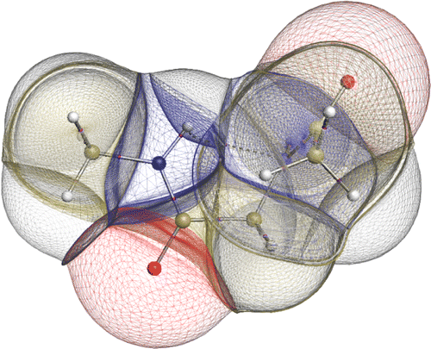

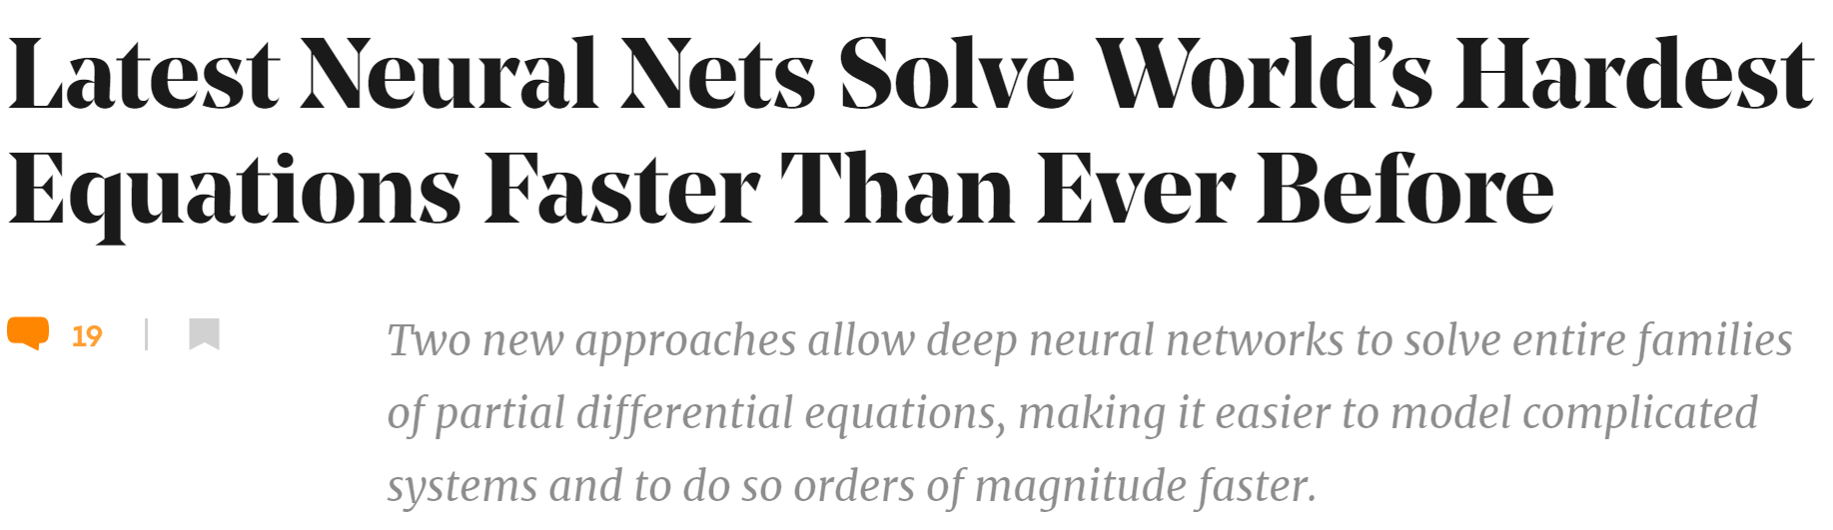
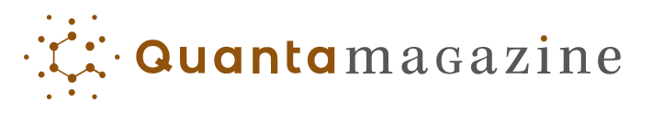
Challenges of Dynamical Systems Modeling and Control
Simulations are crucial for many areas of decision-making and scientific discovery
Need: Improve computational efficiency and scalability for heterogenous scientific simulations
Challenges:
Physically-consistent data-driven modeling
Fast simulation of complex systems
Optimal control and design of complex systems
Emerging solution:
Differentiable programming connecting physics and AI domains

Slide 3
Differentiable Programming
Differentiable Programming
M. Innes, et al., A Differentiable Programming System to Bridge Machine Learning and Scientific Computing, 2019
Physics-informed Neural Networks
M. Raissi, et al., Physics-informed neural networks: A deep learning framework for solving forward and inverse problems involving nonlinear partial differential equations, 2019
Neural Differential Equations
R. T. Q. Chen, et al., Neural Ordinary Differential Equations, 2019
C. Rackauckas , et al., Universal Differential Equations for Scientific Machine Learning, 2021
Differentiable Optimization
A. Agrawal, et al., Differentiable Convex Optimization Layers, 2019
P. Donti, et al., DC3: A learning method for optimization with hard constraints, 2021
S. Gould, et al., Deep Declarative Networks: A New Hope, 2020
J. Kotary, et al., End-to-End Constrained Optimization Learning: A Survey, 2021
Differentiable Control
B. Amos, et al., Differentiable MPC for End-to-end Planning and Control, 2019
S. East, et al., Infinite-Horizon Differentiable Model Predictive Control, 2020
A. Agrawal, et al., Learning Convex Optimization Control Policies, 2020.

Slide 4
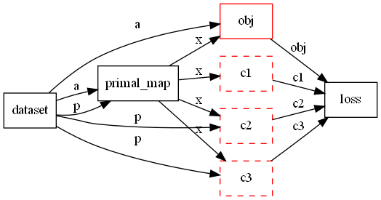
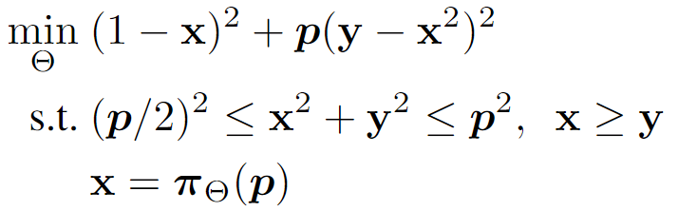

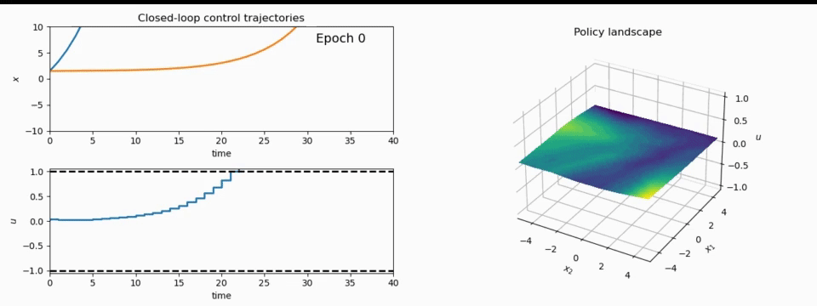
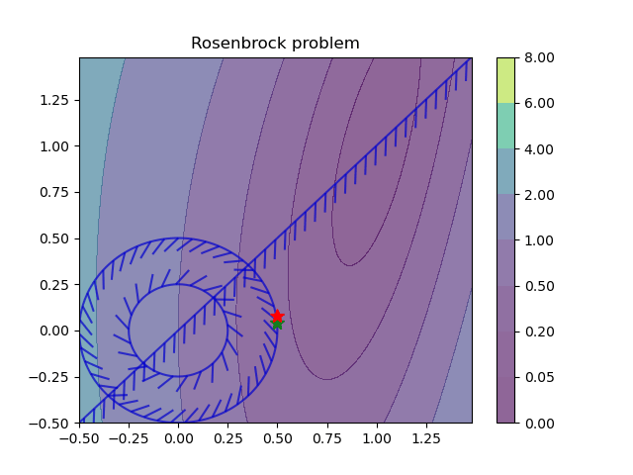
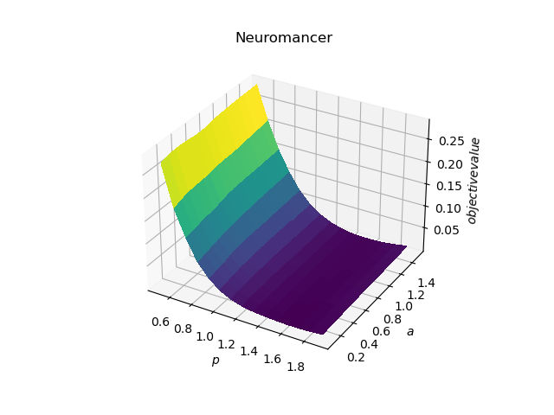
NeuroMANCER: a Differentiable Programming Library
1. Mathematical formulation
3. Problem graph
map
2. Python code interface
4. Results
import neuromancer as nm
p = nm.variable(‘p’)
x = nm.variable(‘x’)
y = nm.variable('y’)
obj = ((1-x)**2 + p*(y-x**2)**2).minimize(weight=1.0, name='obj’) c1 = (p/2)**2 <= x**2 + y**2
c2 = x**2 + y**2 <= p**2
c3 = x >= y net = nm.MLP(insize=2, outsize=2, hsizes=[80]*4) map = nm.Node(net, input_keys=['p’], output_keys=[‘x’,‘y’])
loss = nm.PenaltyLoss([obj], [c1, c2, c3]) problem = nm.Problem([map], loss)
optimizer = torch.optim.AdamW(problem.parameters()) trainer = nm.Trainer(problem,data,optimizer)
best_model = trainer.train()

Slide 5
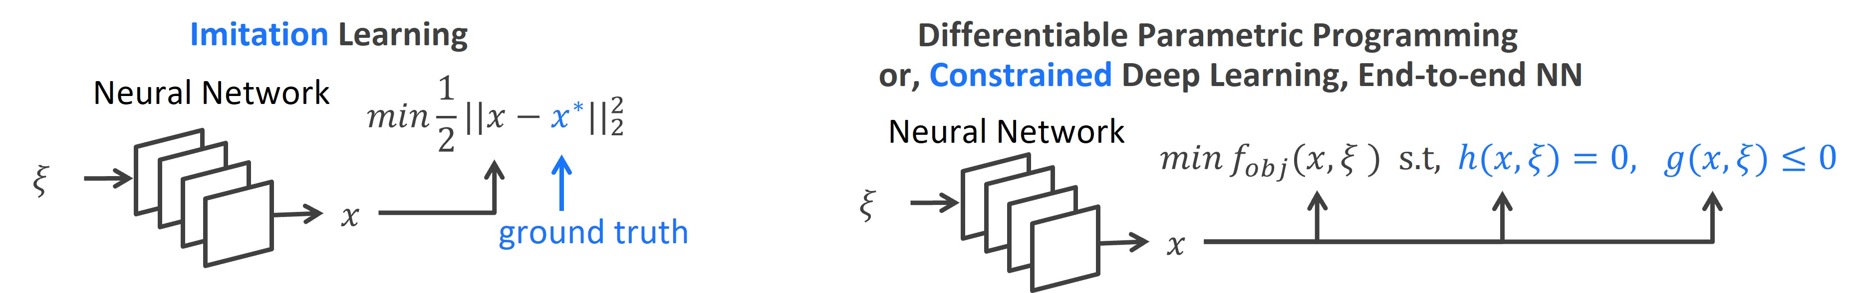
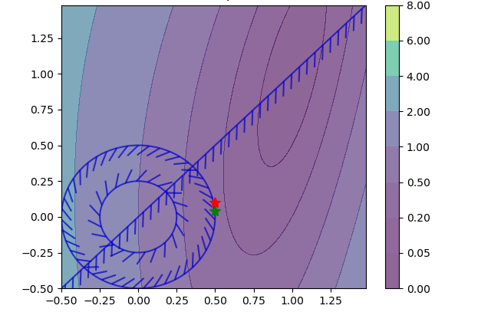
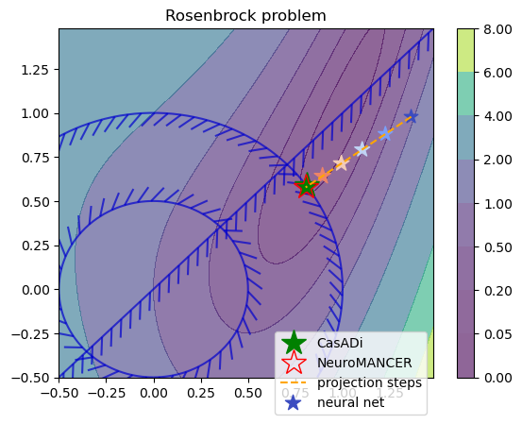
Learning to Optimize in Neuromancer
Training neural networks as explicit solutions
Feasibility restoration with implicit layers

Slide 6
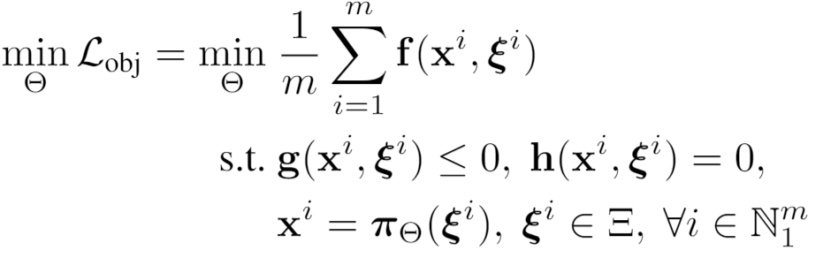
Differentiable Parametric Programming: Generalization of Physics-informed Neural Networks
Problem formulation:

Slide 7
Differentiable Parametric Programming: Generalization of Physics-informed Neural Networks
Objective function
Problem formulation:
Constraints
Primal optimizers
Scenarios
Solution map
Parameters

Slide 8
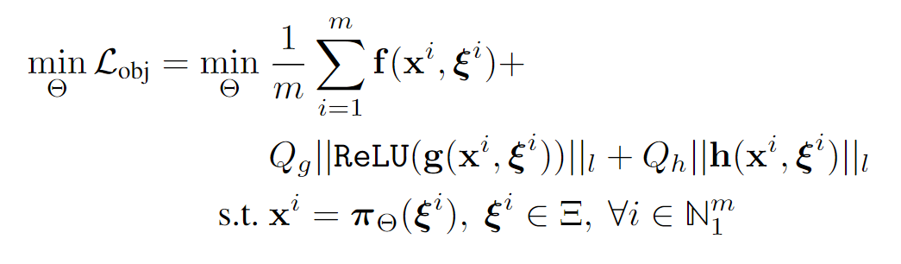
Differentiable Parametric Programming: Generalization of Physics-informed Neural Networks
Objective function
Problem formulation:
Constraints
Primal optimizers
Scenarios
Solution map
Parameters
Lagrangian form:
Constraints penalties
Gradient-based optimization

Slide 9
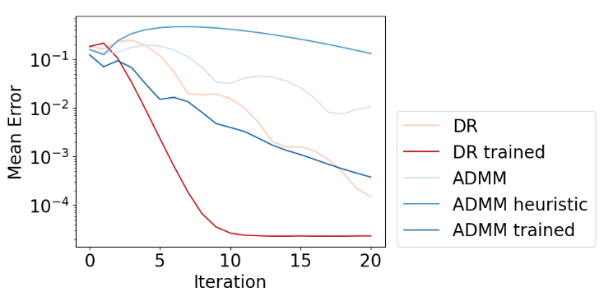
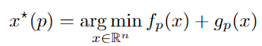
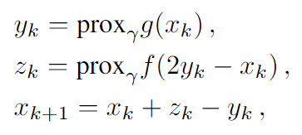
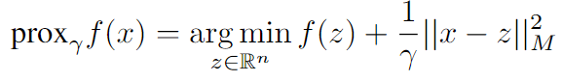
Metric Learning to Accelerate Convergence of Operator Splitting Methods
Parametric programming setting:
Douglas-Rachford splitting (DR) algorithm:
We can accelerate convergence of DR and ADMM algorithms via end-to-end metric learning.
Idea: Train neural network to optimize the metric as a function of problem parameters:
Ethan King, James Kotary, Ferdinando Fioretto, Jan Drgona, Metric Learning to Accelerate Convergence of Operator Splitting Methods for Differentiable Parametric Programming, Under review for CDC 2024.

Slide 10
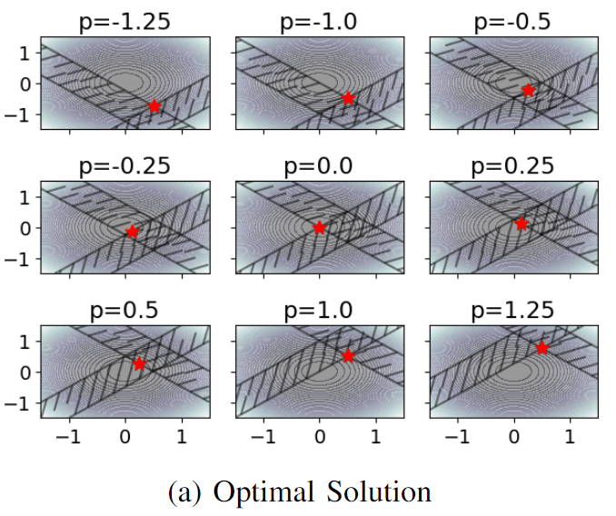
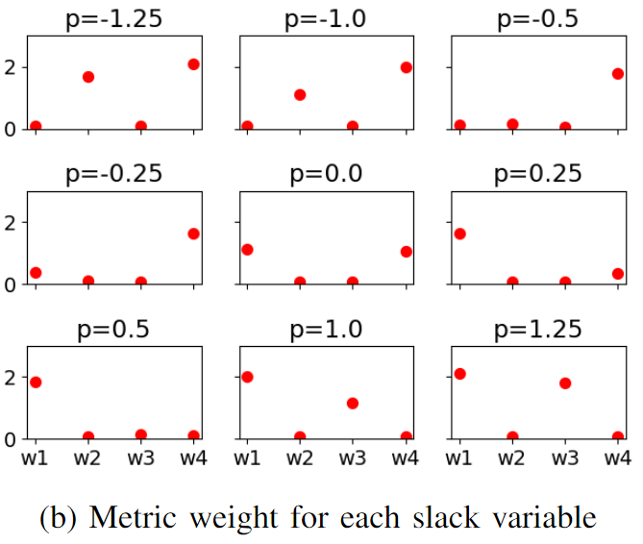
Metric Learning is a Form of Active Set Prediction
Ethan King, James Kotary, Ferdinando Fioretto, Jan Drgona, Metric Learning to Accelerate Convergence of Operator Splitting Methods for Differentiable Parametric Programming, Under review for CDC 2024.

Slide 11
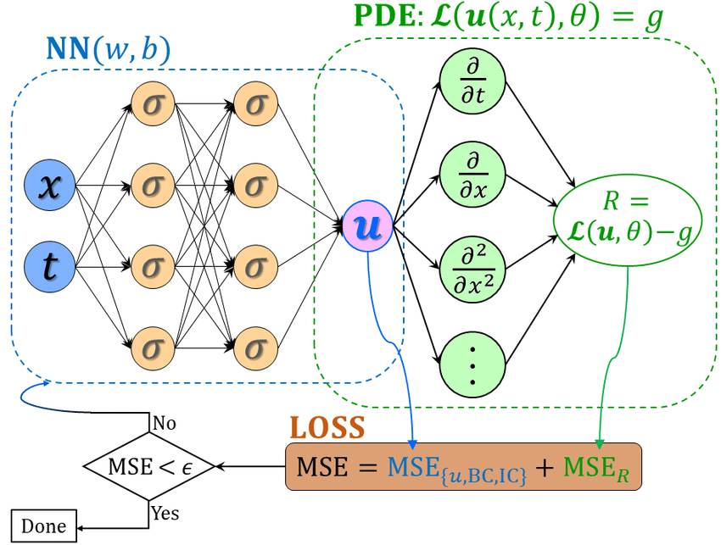
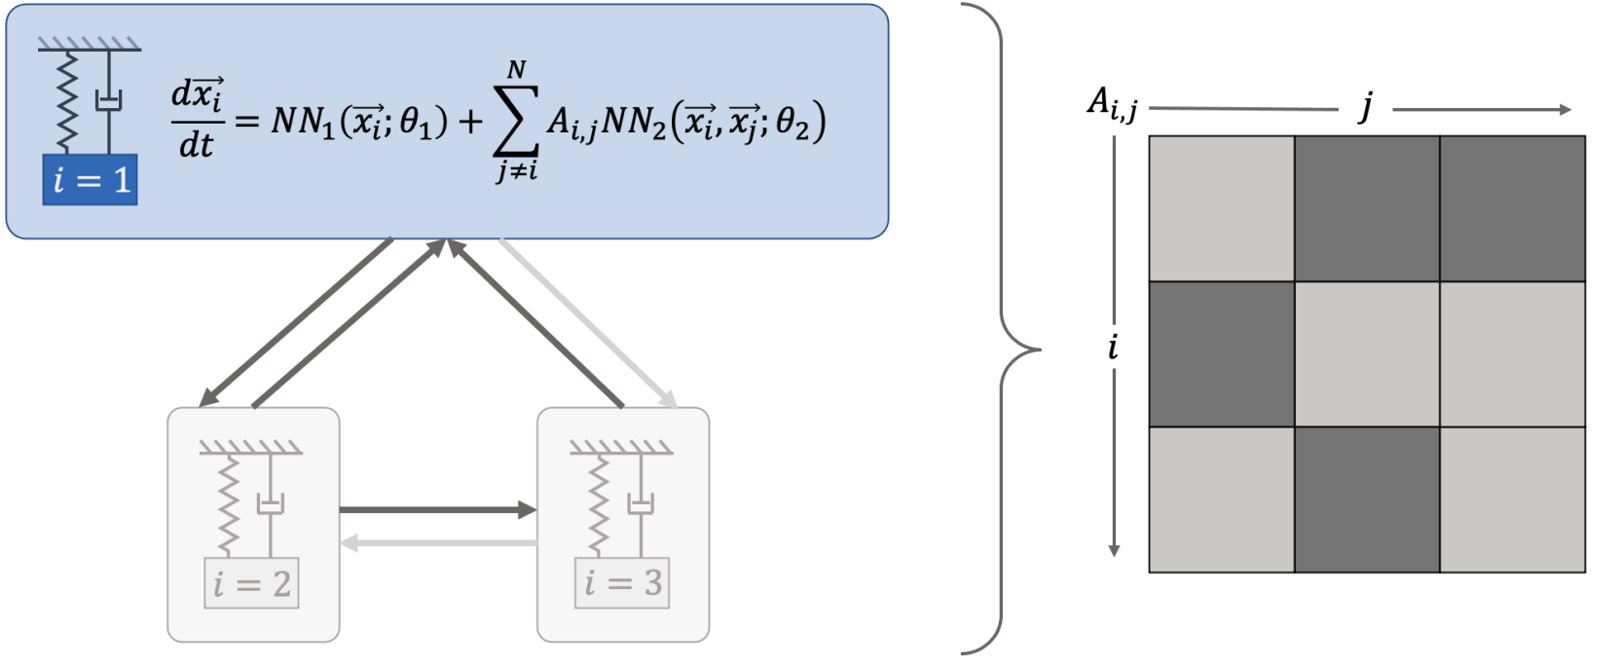
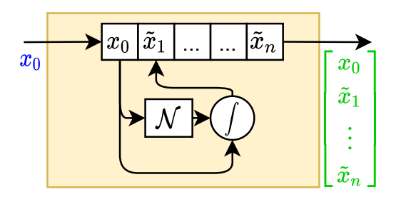
Learning to Model in Neuromancer
Component-based Physics-informed Machine Learning
Physics-Informed Neural Networks
Networked Dynamical systems
Neural differential equations

Slide 12
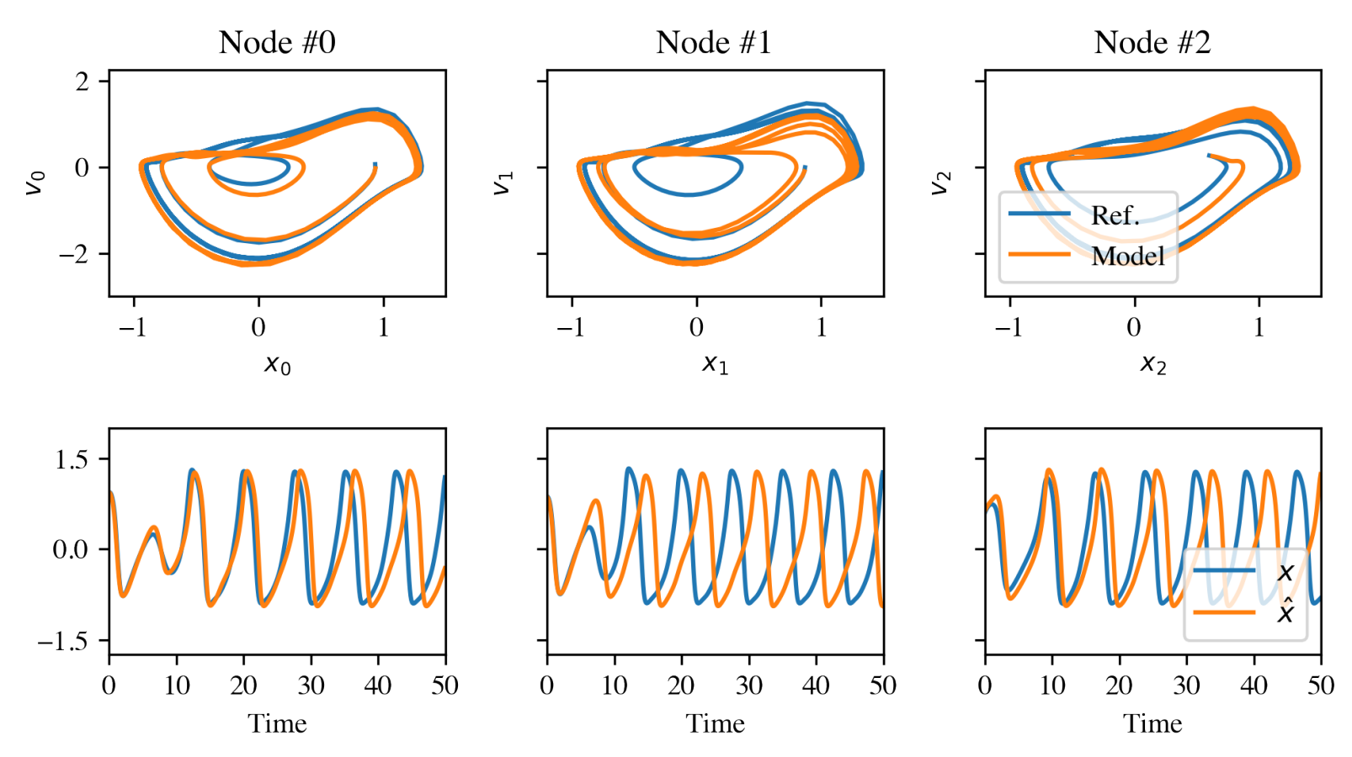
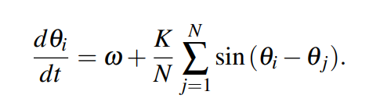
Networked Dynamical Systems via Universal Differential Equations
Network of unknown oscillators
Coupling adjacency
Generalization of learned dynamics on never-seen network topology.
Ground truth Kuramoto system:
James Koch, et al., Structural Inference of Networked Dynamical Systems with Universal Differential Equations, Chaos: An interdisciplinary Journal of Nonlinear Science, doi.org/10.1063/5.0109093, 2023

Slide 13
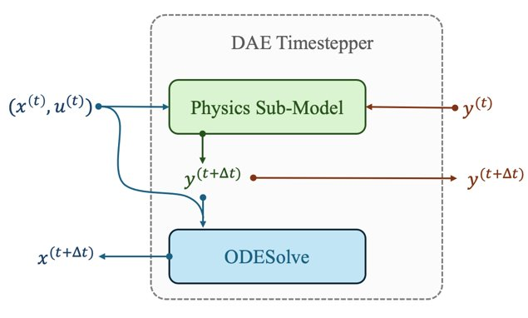
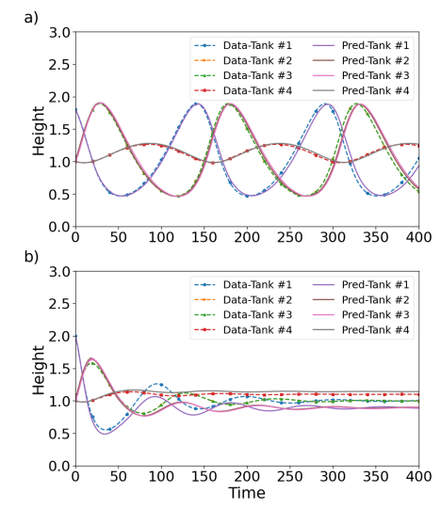
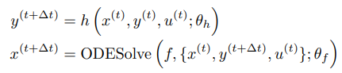
Neural Differential Algebraic Equations
Trained with physics-informed loss function:
Time stepper architecture is inspired by Lie-Trotter operator splitting method:
Inverse modeling, robustness to noise and, out of distribution generalization.
J. Koch, M. Shapiro, H. Sharma, D. Vrabie, J. Drgona, Neural Differential Algebraic Equations, arXiv:2403.12938, 2024.

Slide 14
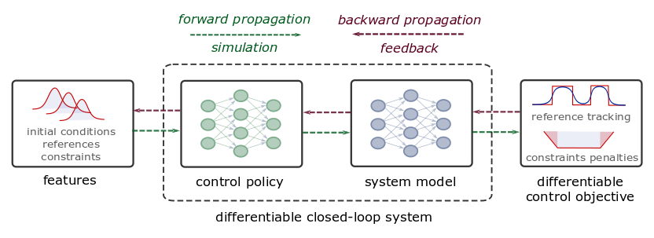
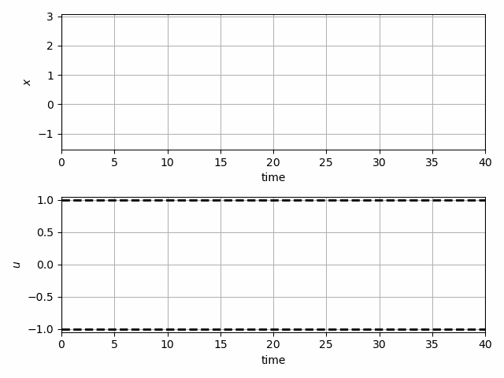
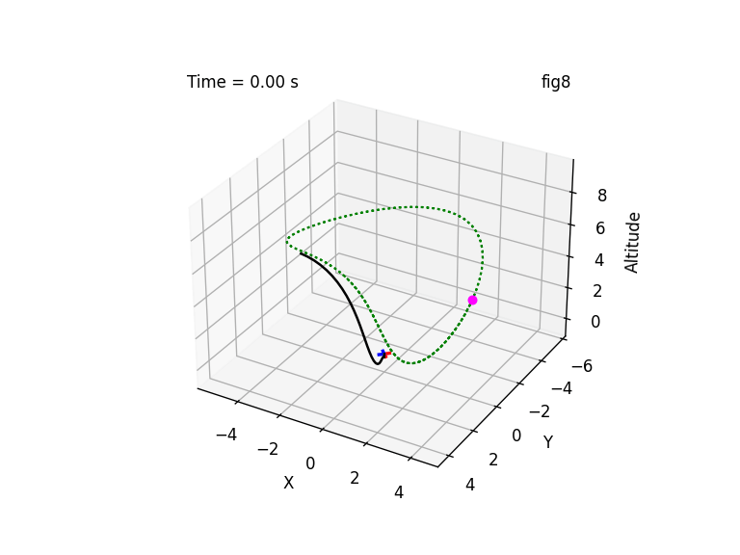
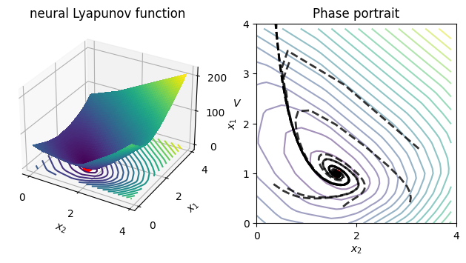
Learning to Control in Neuromancer
Differentiable predictive control
Learning stabilizing controllers
Trajectory optimization and obstacle avoidance
Learning Neural Lyapunov Functions

Slide 15


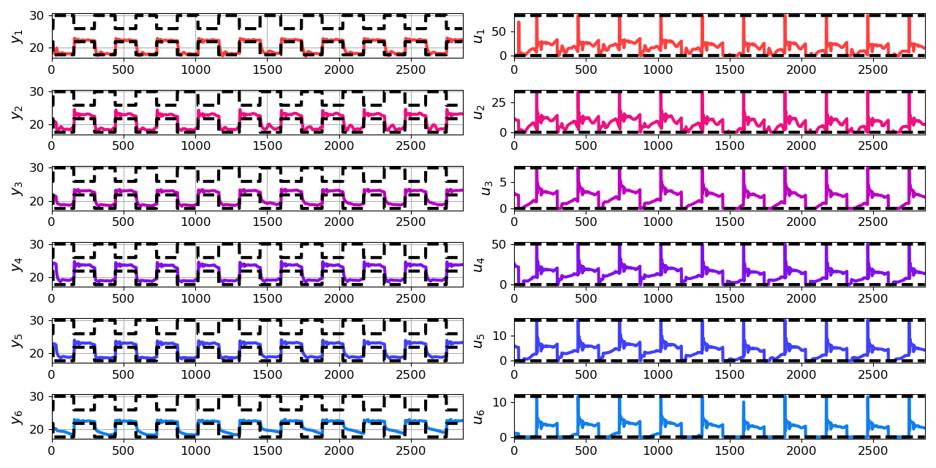
Learning to Control Building Energy Systems
Architectures
Neural state space dynamics model
MLP control policy architecture
Results
Multi-input multi-output system dynamics
Dynamic economic control objective
Parametric constraints
Jan Drgona, Aaron Tuor, Elliott Skomski, Soumya Vasisht, Draguna Vrabie, Deep Learning Explicit Differentiable Predictive Control Laws for Buildings, IFAC NMPC 2021

Slide 16
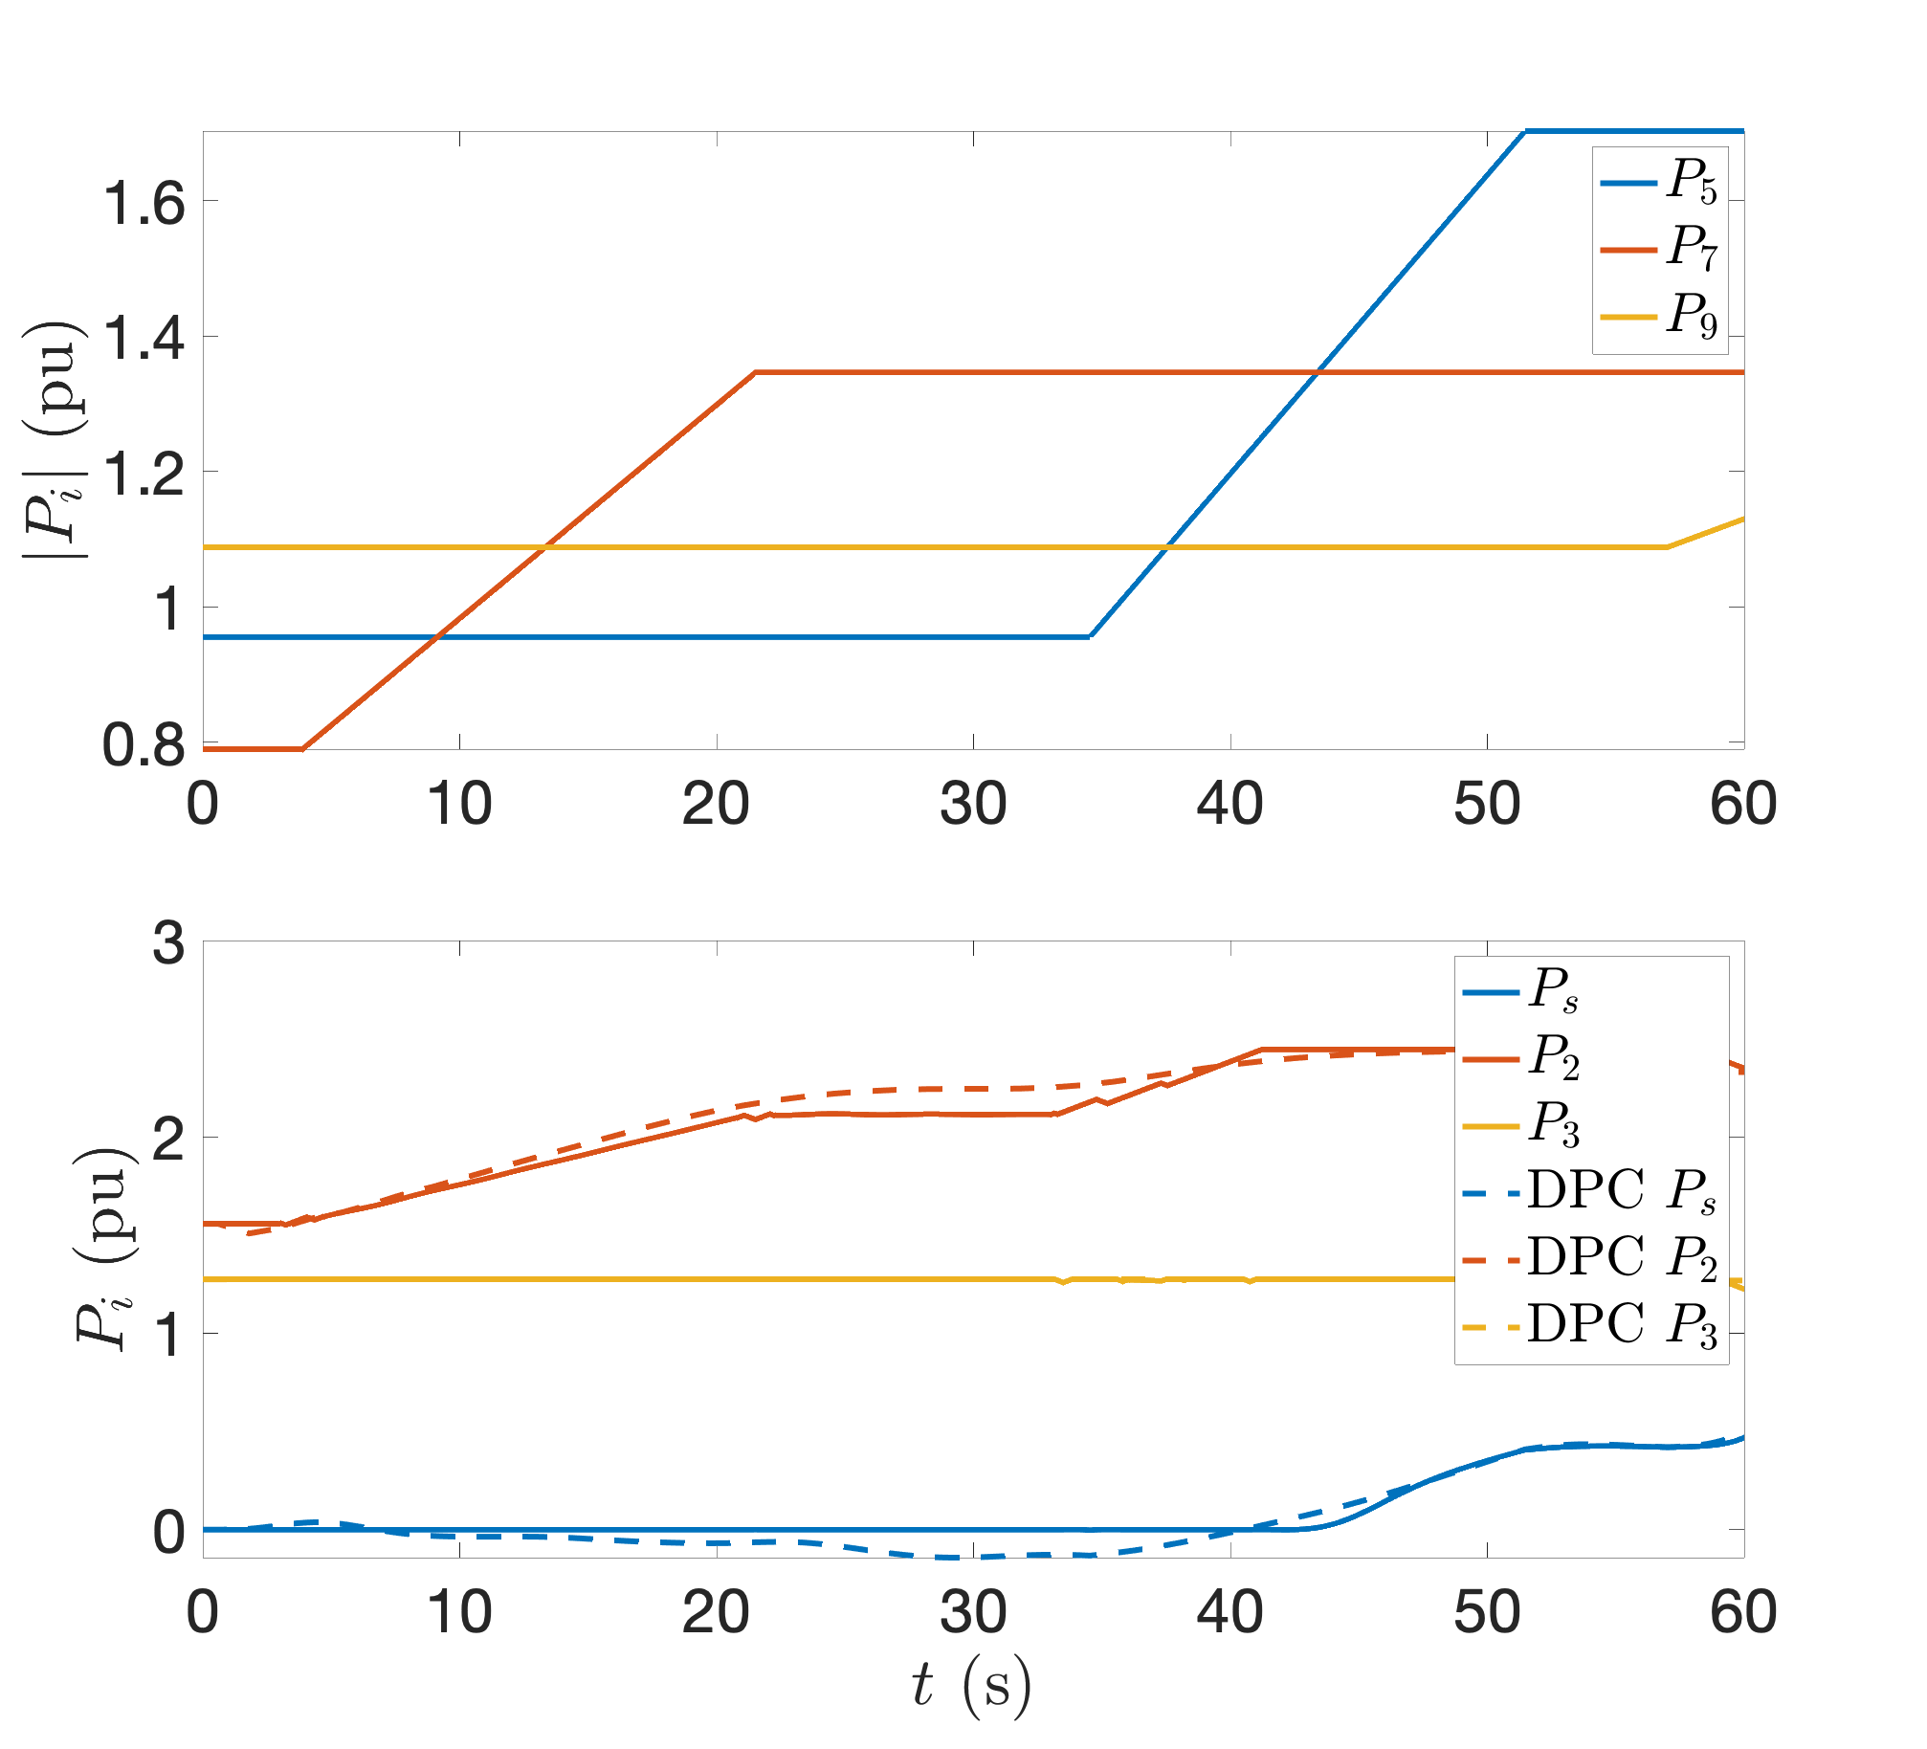
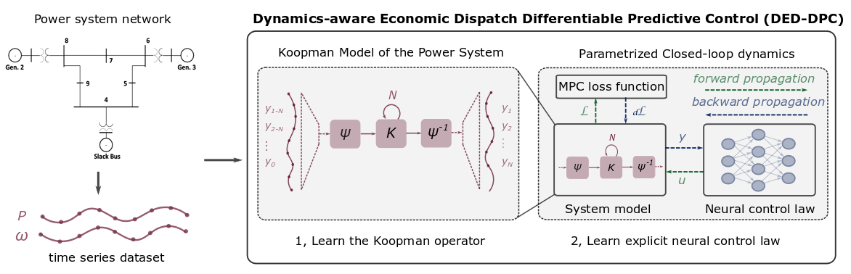
Learning to Solve Dynamic Economic Dispatch
Problem: Current dispatch processes do not incorporate system dynamics concerns. Incorporating dynamics in economic dispatch is too complex and time-consuming.
Architectures
Koopman dynamics model
CNN control policy
Solution: Machine-learning based dynamics-aware dispatch. Learn system dynamics and control policies for faster assessment.
Results
5 orders of magnitude speed-up
Near optimal performance
Ethan King, Ján Drgoňa, Aaron Tuor, Shrirang Abhyankar, Craig Bakker, Arnab Bhattacharya, Draguna Vrabie, Koopman-based Differentiable Predictive Control for the Dynamics-Aware Economic Dispatch Problem, 2022 American Control Conference

Slide 17



NeuroMANCER
Open-source scientific machine learning (SciML) toolbox in Pytorch integrating deep learning, constrained optimization, and physics-based modeling
Learning to optimize
Learning to control
Nonlinear system identification
Physics-informed neural networks
github.com/pnnl/neuromancer
www.youtube.com/@neuromancer_SciML
drgona.github.io

Slide 18


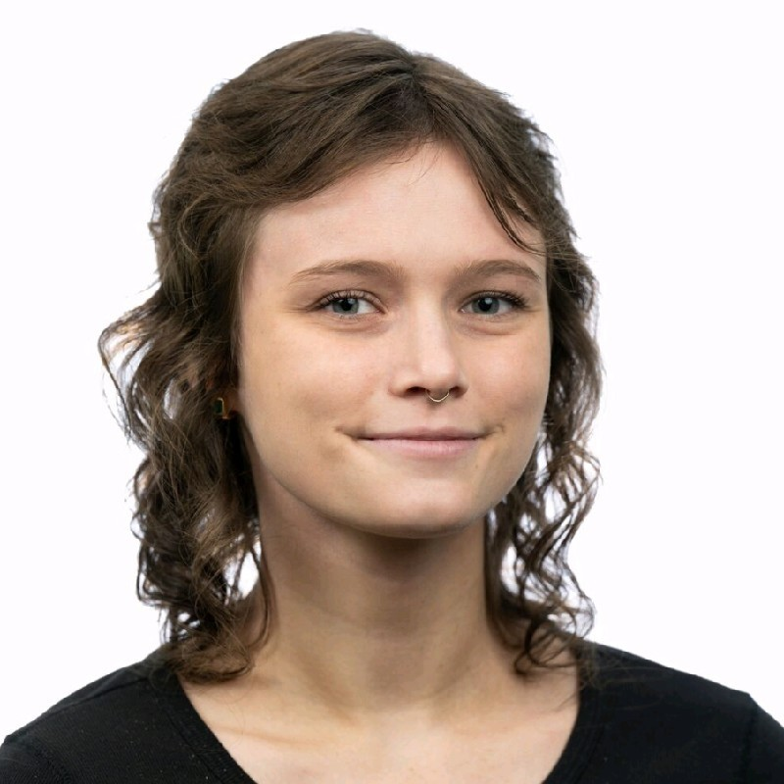







Acknowledgements
Aaron Tuor
James Koch
Madelyn Shapiro
Stefan Dernbach
Rahul Birmiwal
Wenceslao Shaw Cortez
Ethan King
Shrirang Abhyankar
Mahantesh Halappanavar
Draguna Vrabie

